Slide 1

CSYE 7374
Deep Learning & Generative Model in Healthcare
Final Project
Presentation
Chia Lin Chang

Slide 2


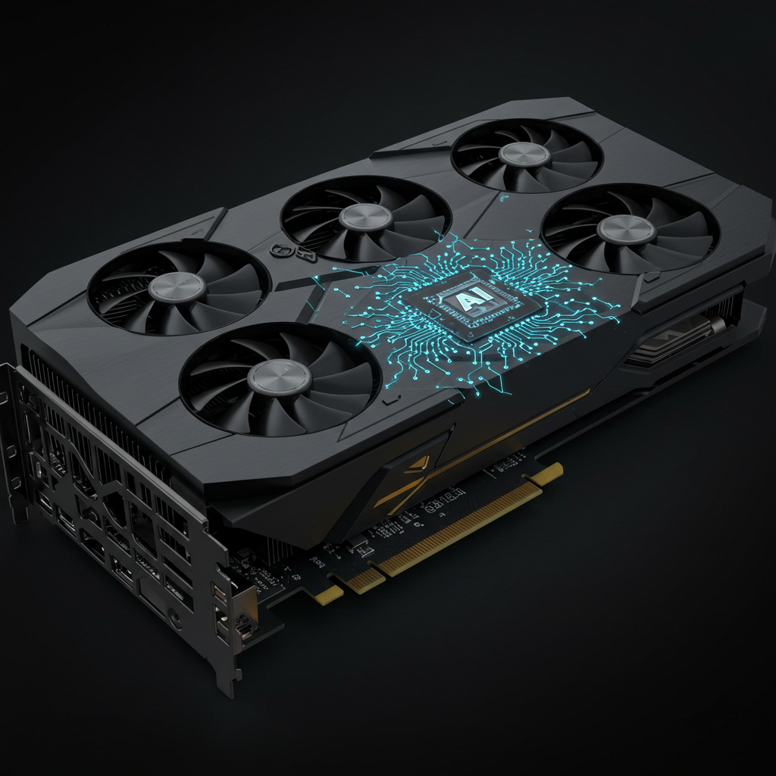
Background and Motivation:

Slide 3
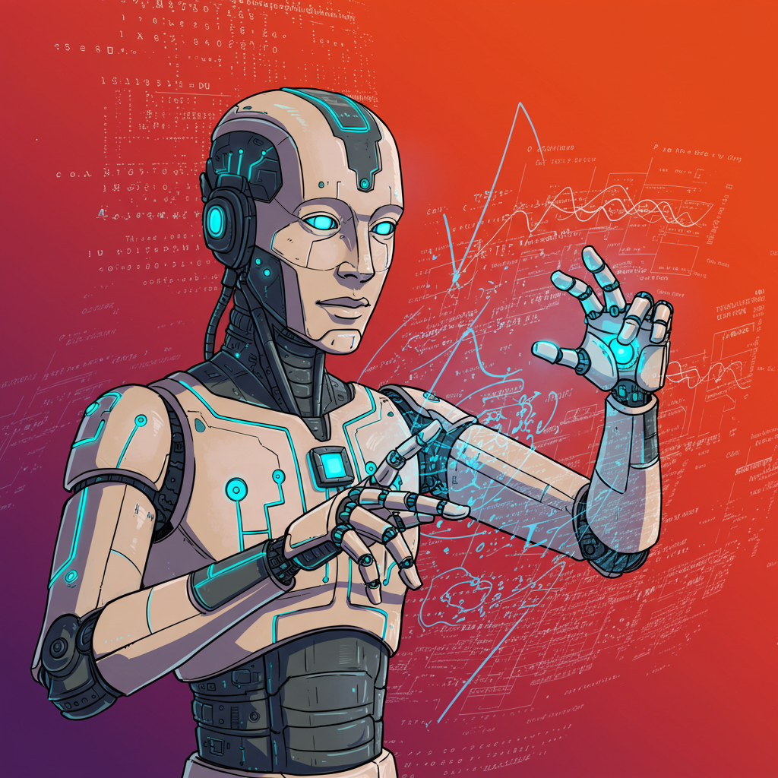
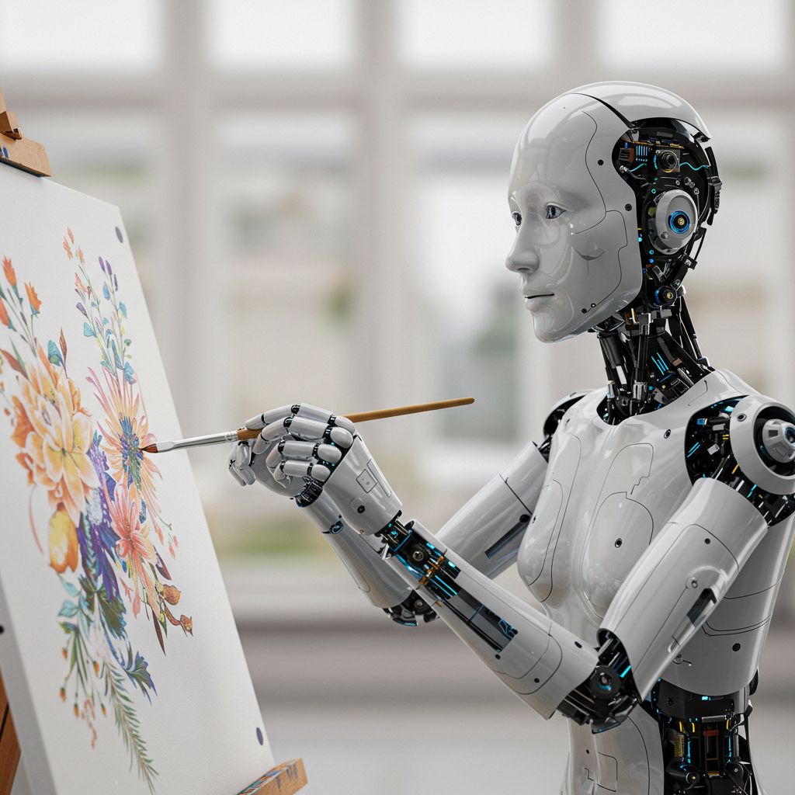
Background and Motivation:

Slide 4
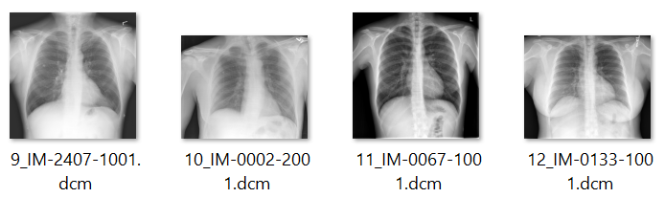

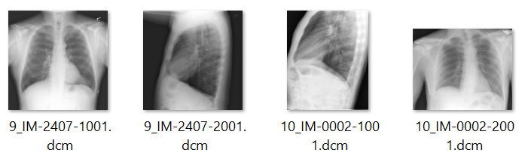
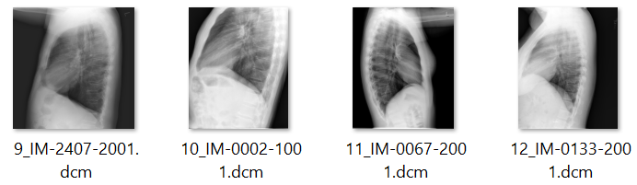

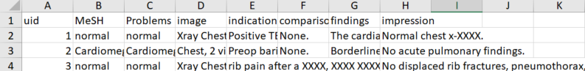
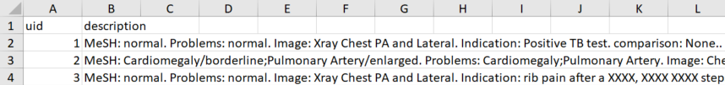
Methodology and Architecture :
Section 1: Install and Import packages.
Section 2: Download the dataset from “Kaggle” (Chest X-ray Images with corresponding reports).
Section 3: Release the memory of GPU.
Section 4: Data Curation.
Section 5: Extract the Reports and Uid from the CSV file and create a new CSV file.
Frontal
Lateral

Slide 5
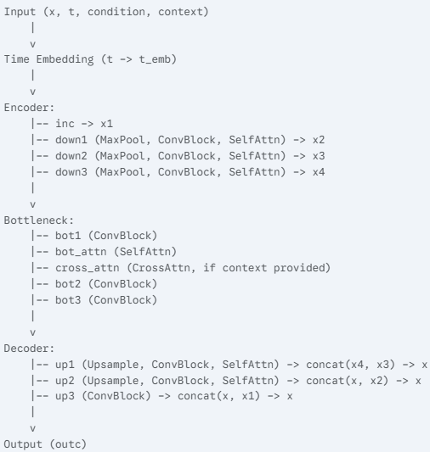
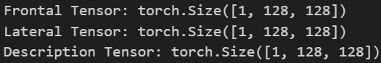
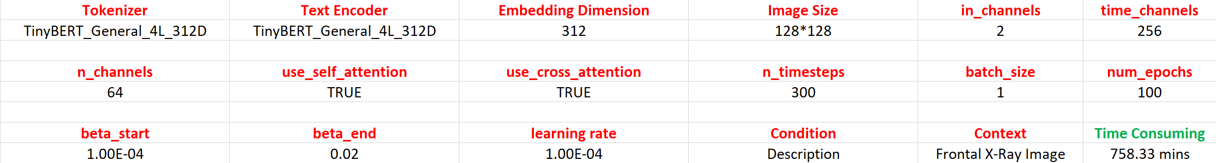
Methodology and Architecture :
Section 6: Dataset and Data loader
Section 7: Model (U-net Model for Denoising process)
Section 8: Diffusion Process
Section 9: Training Section
Section 10: Validation with 50 data
Section 11: Generate X-Ray Image (Lateral) by input text

Slide 6
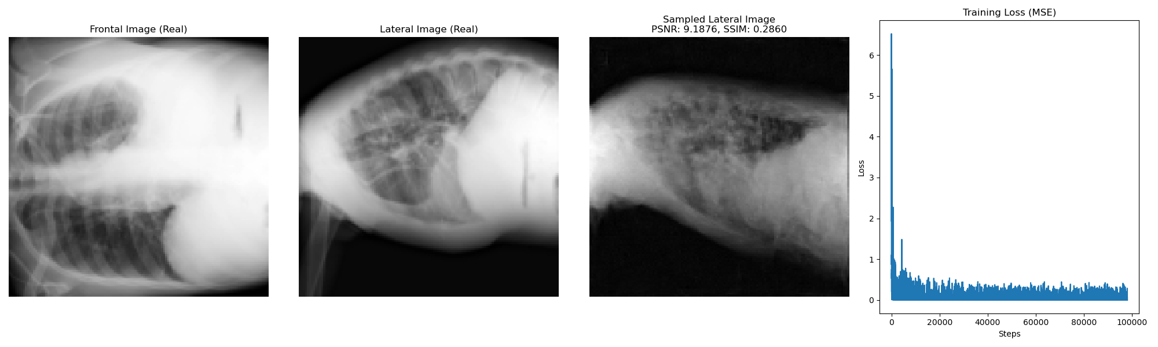
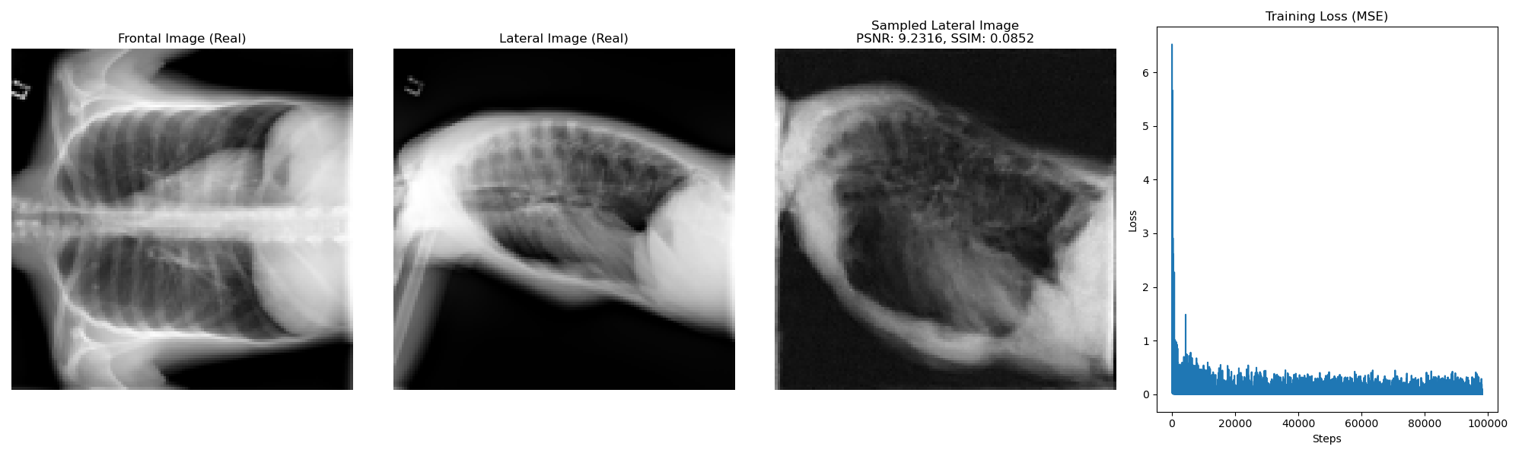
Results and Discussion :
Training Process

Slide 7
Results and Discussion :
Validation

Slide 8

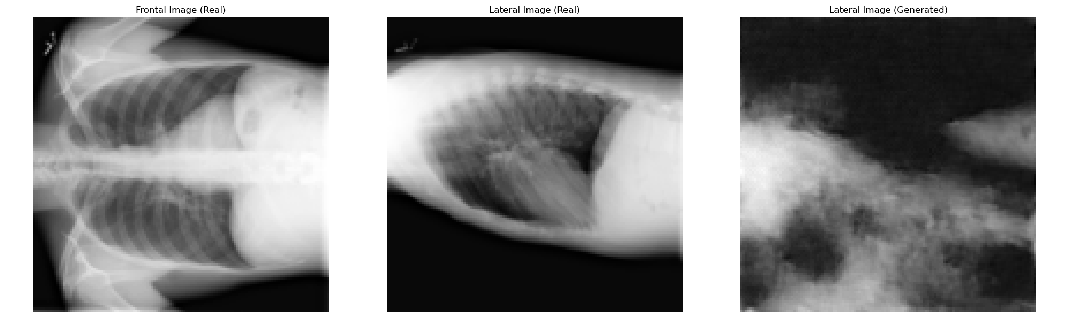
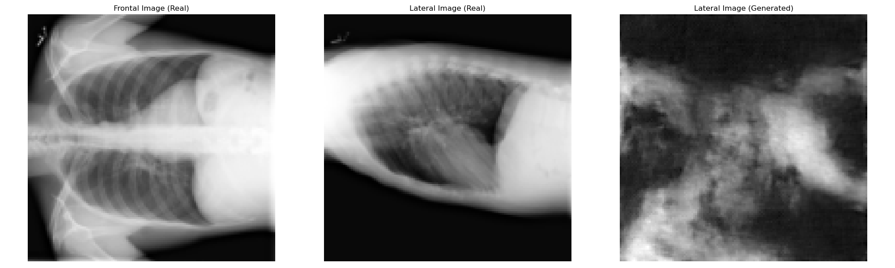
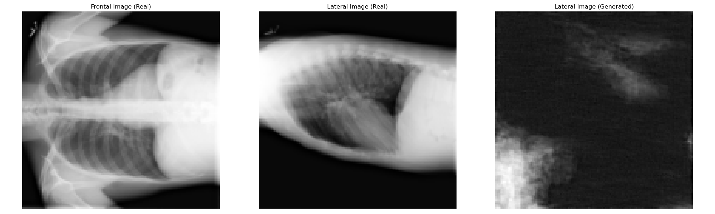
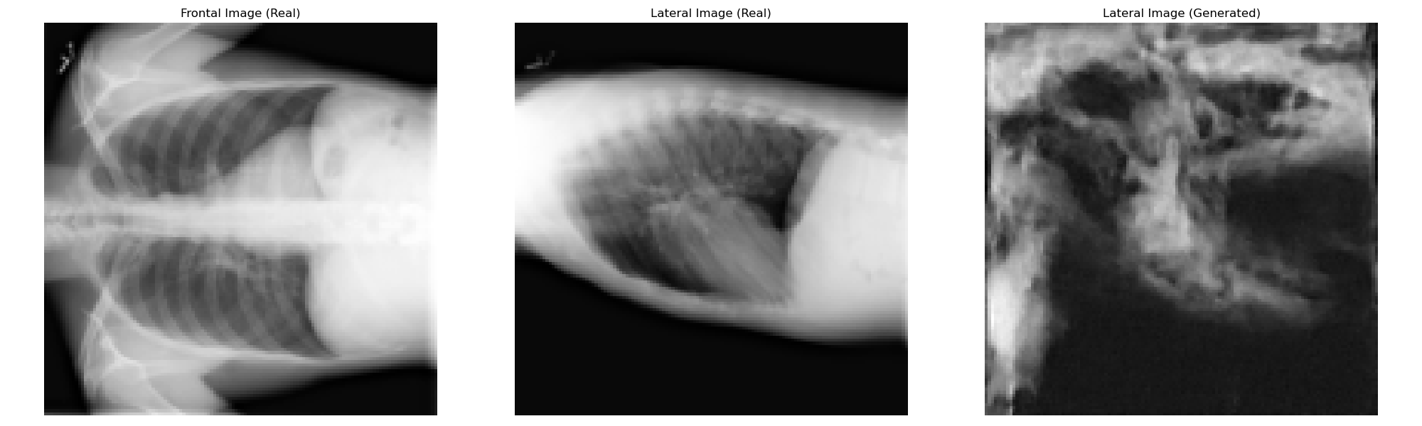
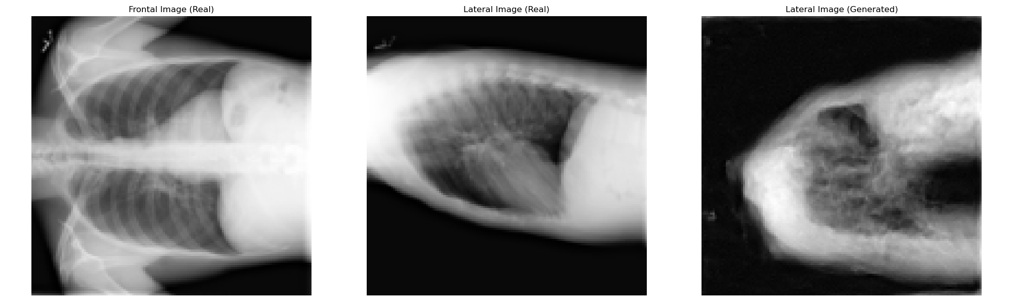
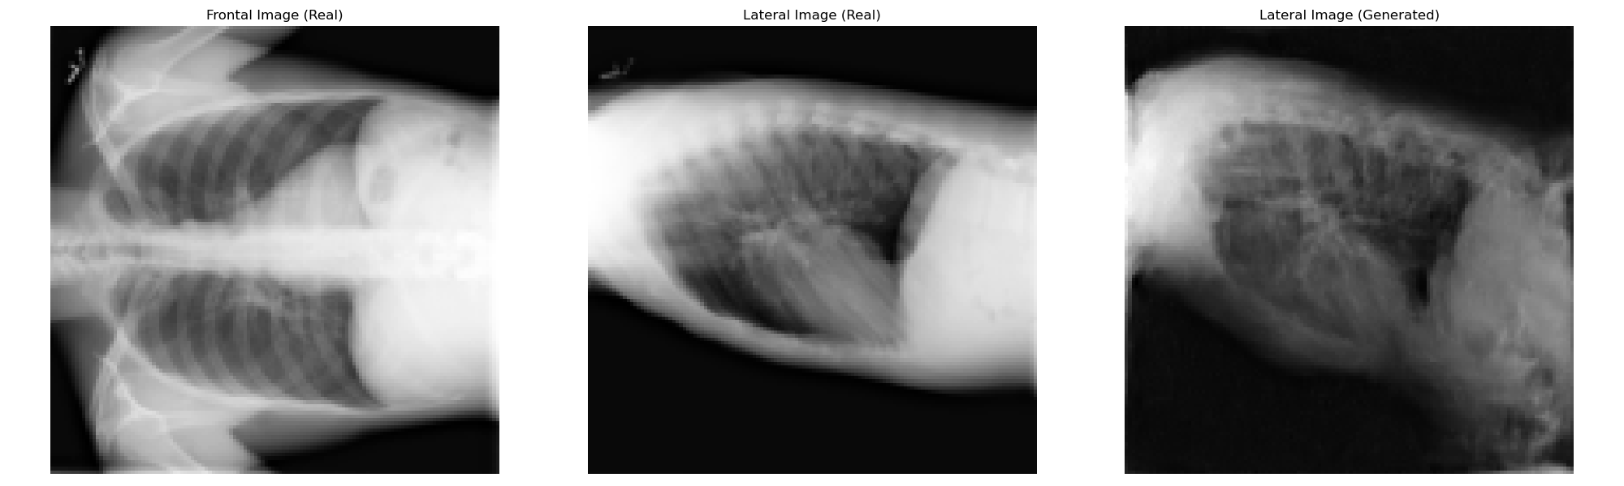
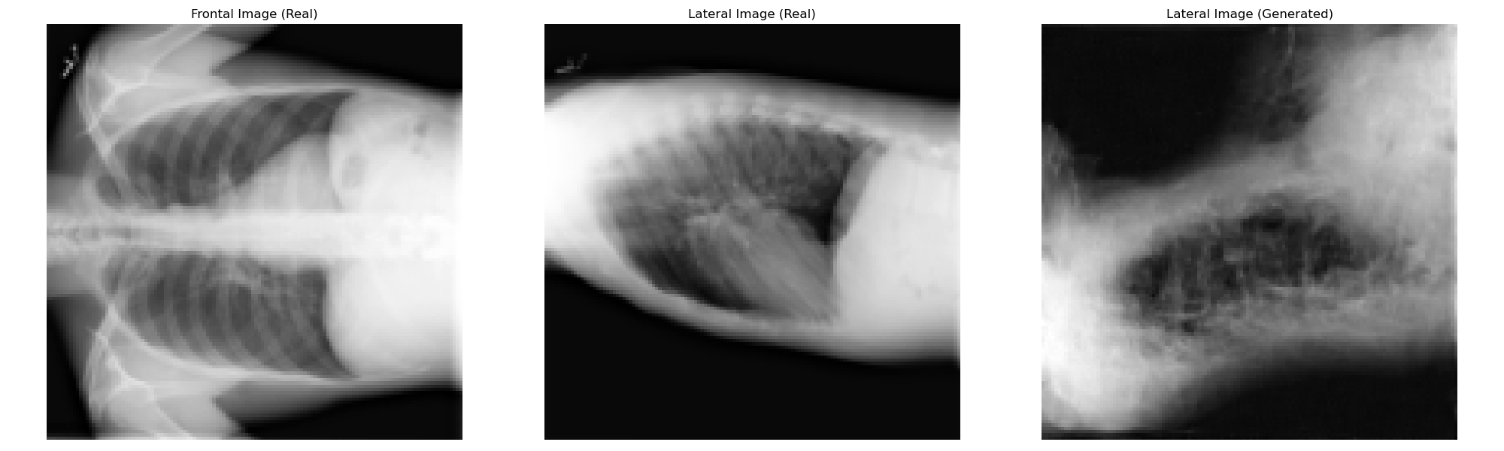
Validation (Condition: Description, Context: Description)
20 Epochs
40 Epochs
60 Epochs
80 Epochs
100 Epochs

Slide 9
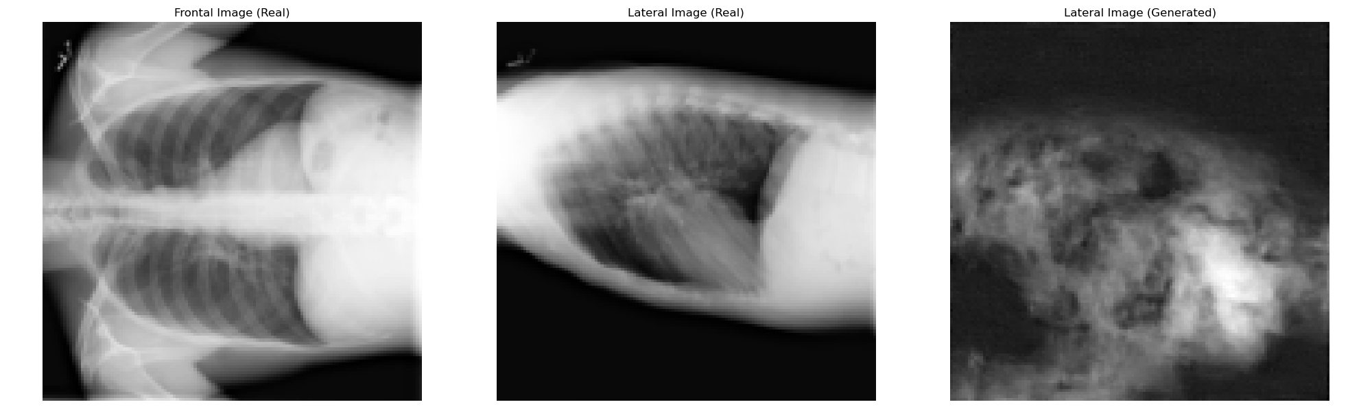
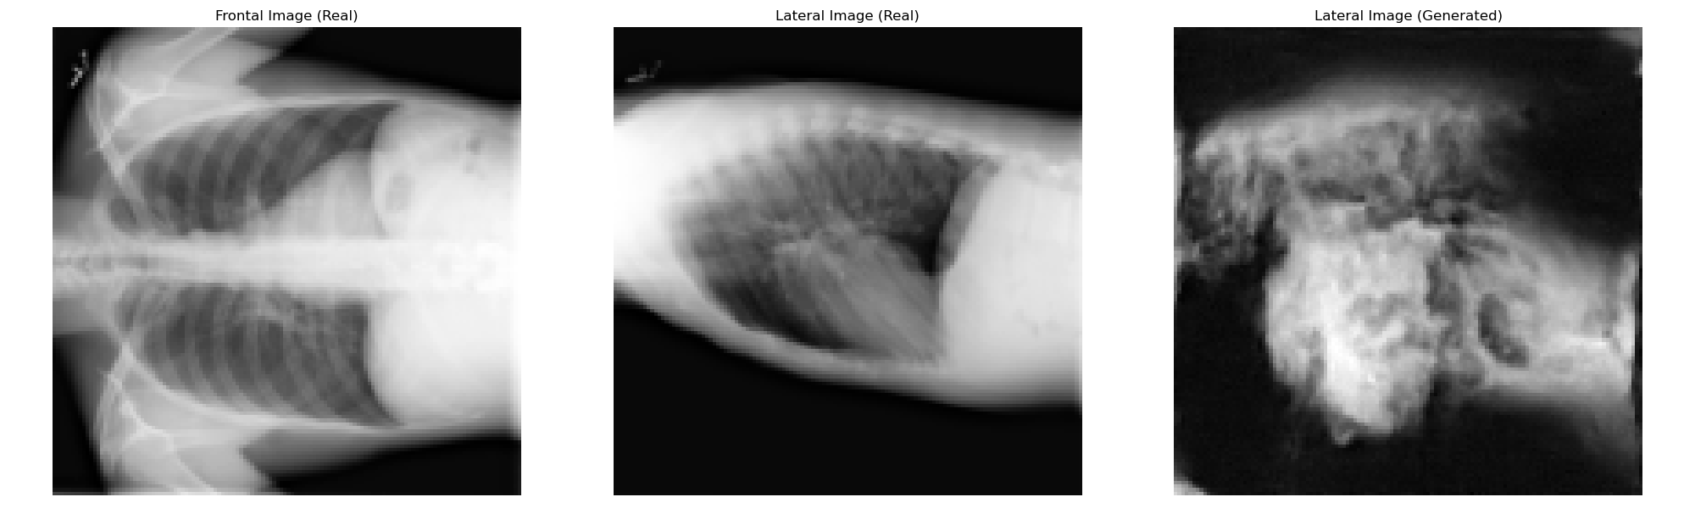
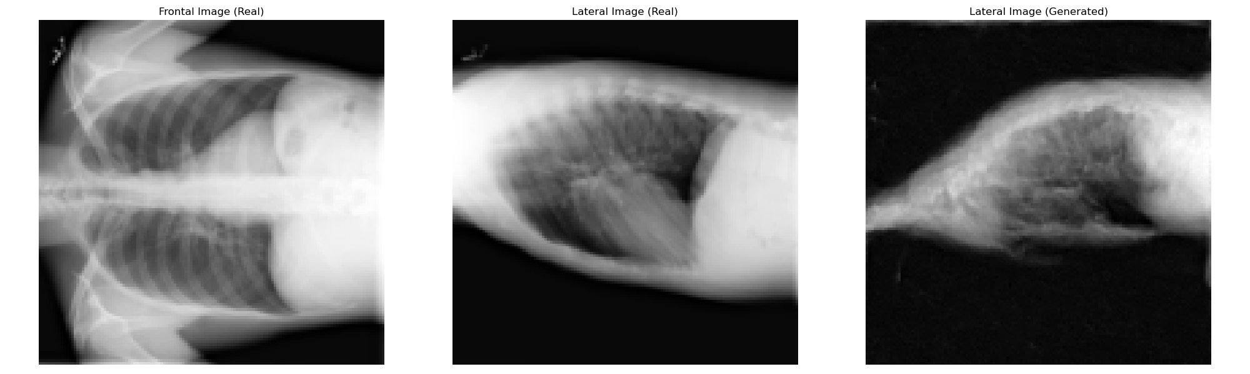
Validation (Condition: Description, Context: Frontal X-ray Image)
20 Epochs
40 Epochs
60 Epochs
80 Epochs
100 Epochs

Slide 10
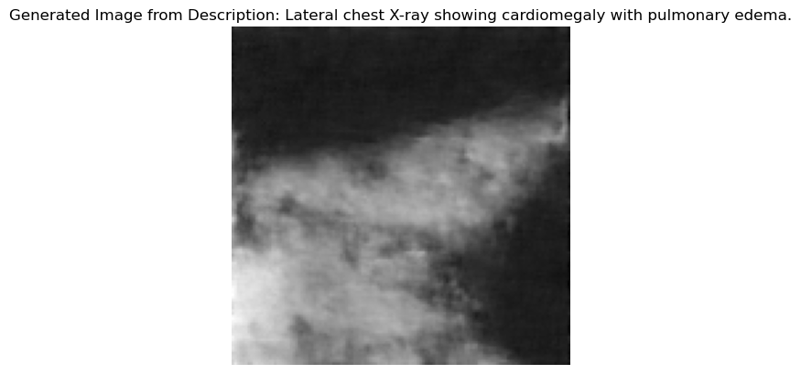
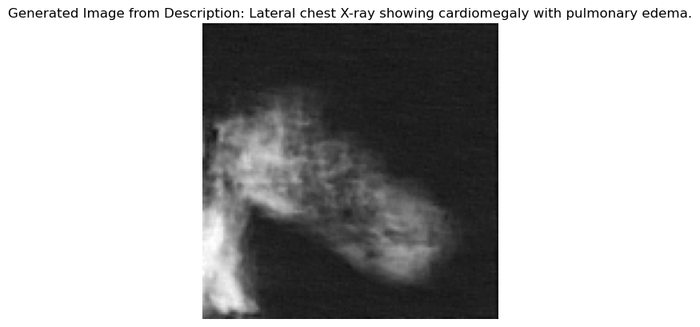
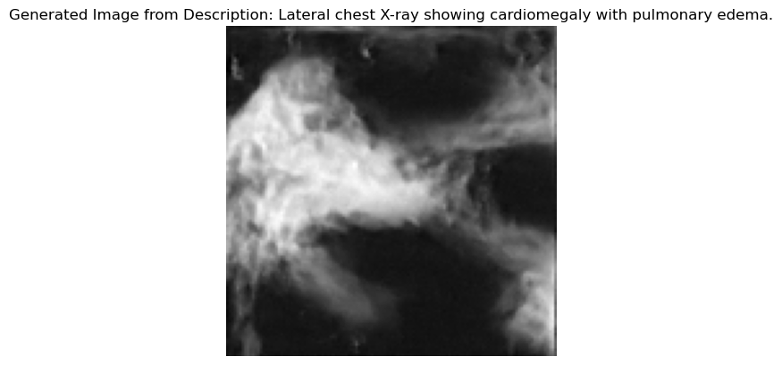
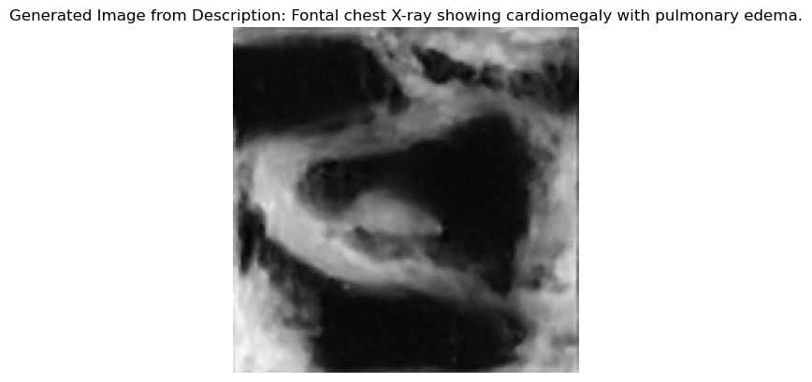
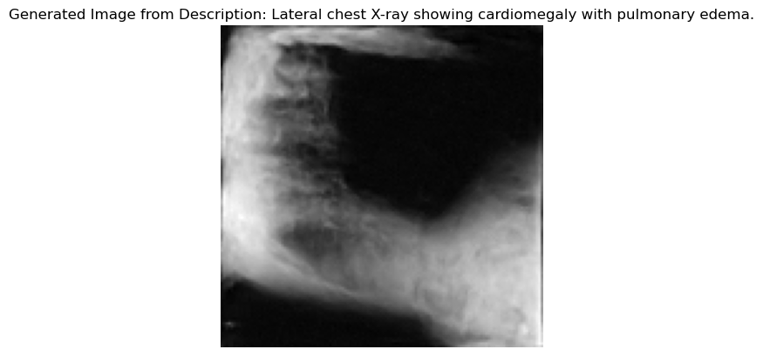
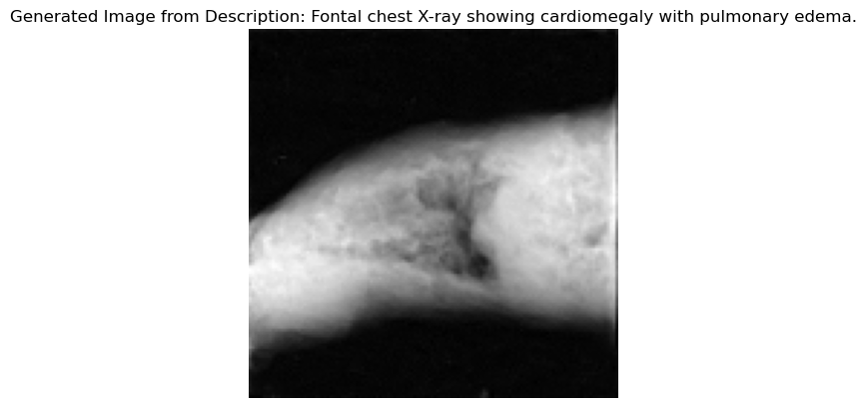
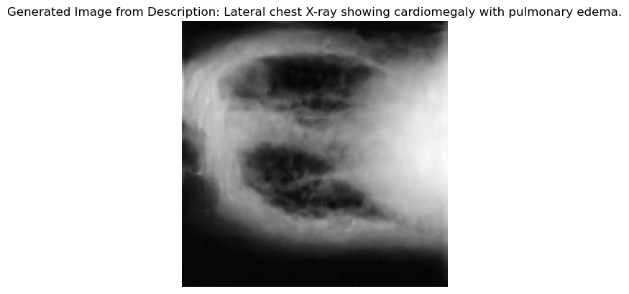
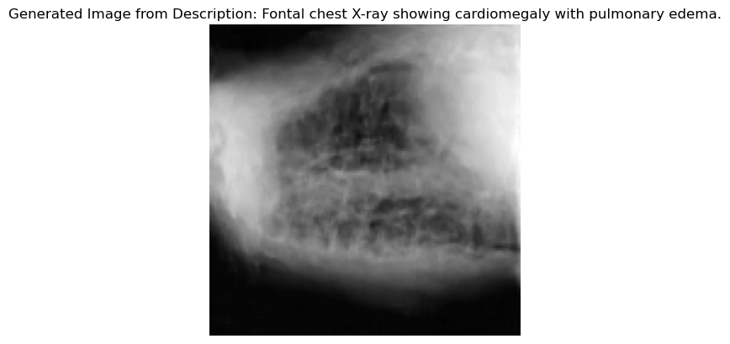
Results and Discussion :
Text input : Lateral chest X-ray showing cardiomegaly with pulmonary edema.
20 Epochs
40 Epochs
60 Epochs
80 Epochs
100 Epochs

Slide 11
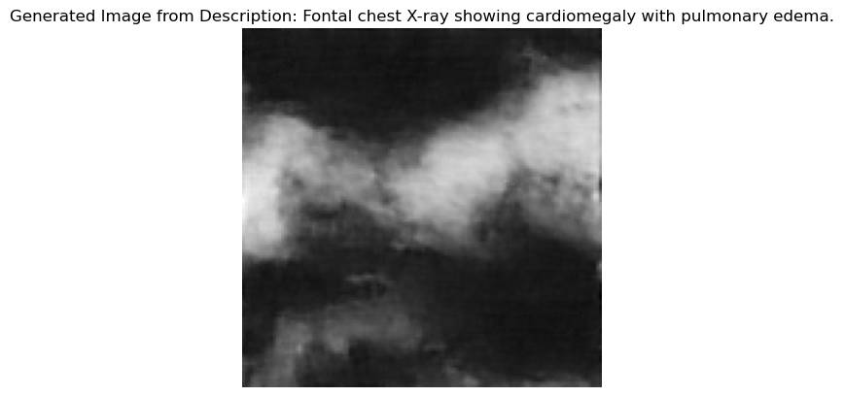
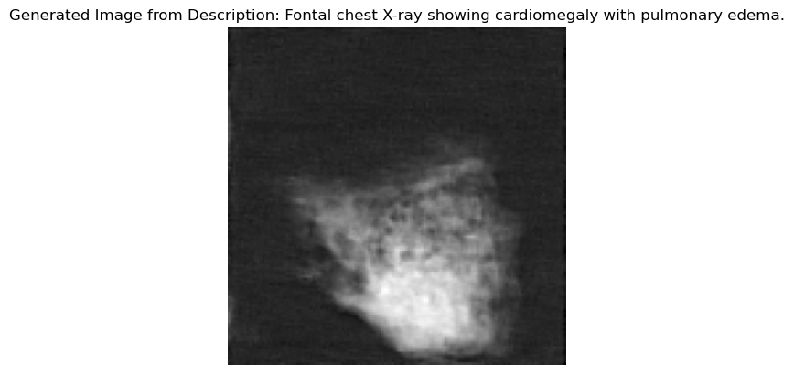
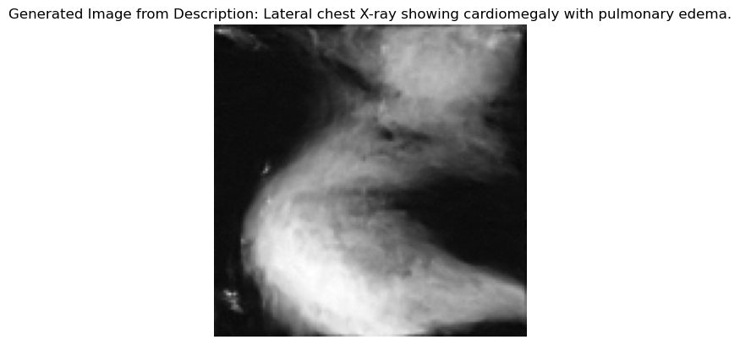
Results and Discussion :
Text input : Frontal chest X-ray showing cardiomegaly with pulmonary edema.
20 Epochs
40 Epochs
60 Epochs
80 Epochs
100 Epochs

Slide 12
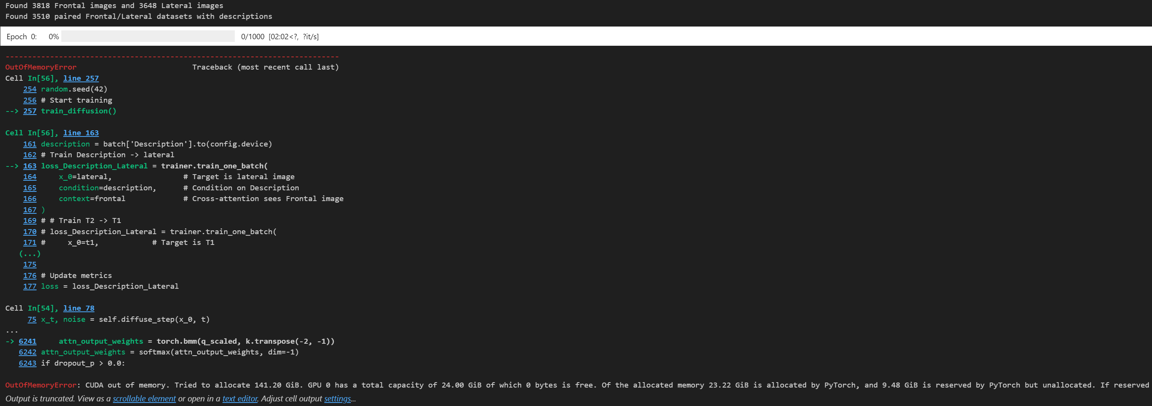
Conclusion and Future direction:

